Slide 1


Ganesshh T.L

Slide 2
Outline
Executive Summary
Introduction
Methodology
Results
Conclusion
Appendix
2

Slide 3
Executive Summary
The following methodologies were used to analyze data:
Data Collection using web scraping and SpaceX API;
Exploratory Data Analysis (EDA), including data wrangling, data visualization and interactive
visual analytics;
Machine Learning Prediction.
Summary of all results
It was possible to collected valuable data from public sources;
EDA allowed to identify which features are the best to predict success of launchings;
Machine Learning Prediction showed the best model to predict which characteristics are
important to drive this opportunity by the best way, using all collected data.
3

Slide 4
Introduction
The objective is to evaluate the viability of the new company Space Y to compete with Space X.
Desirable answers:
The best way to estimate the total cost for launches, by predicting successful landings of the
first stage of rockets;
Where is the best place to make launches.
4

Slide 5

5

Slide 6
Methodology
Executive Summary
Data collection methodology:
Data from Space X was obtained from 2 sources:
Space X API (https://api.spacexdata.com/v4/rockets/)
WebScraping (https://en.wikipedia.org/wiki/List_of_Falcon/_9/_and_Falcon_Heavy_launches)
Perform data wrangling
Collected data was enriched by creating a landing outcome label based on outcome data
after summarizing and analyzing features
Perform exploratory data analysis (EDA) using visualization and SQL
6

Slide 7
Methodology
Executive Summary
Perform interactive visual analytics using Folium and Plotly Dash
Perform predictive analysis using classification models
Data that was collected until this step were normalized, divided in training and test data sets and evaluated by four different classification models, being the accuracy of each model evaluated using different combinations of parameters.
7

Slide 8
Data Collection
Data sets were collected from Space X API (https://api.spacexdata.com/v4/rockets/) and from Wikipedia (https://en.wikipedia.org/wiki/List_of_Falcon/_9/_and_Falcon_Heavy_launches), using web scraping technics.
8

Slide 9



Data Collection – SpaceX API
SpaceX offers a public API from where data can be obtained and then used;
This API was used according to the flowchart beside and then data is persisted.
Request API and parse the SpaceX launch data
Filter data to only include Falcon 9 launches
Source code: https://github.com/tflores/applied-data- science- capstone/blob/master/Data%20Collection%20API.ipyn b
Deal with Missing Values
9

Slide 10


Data Collection - Scraping
Data from SpaceX launches can also be obtained from Wikipedia;
Data are downloaded from Wikipedia according to the flowchart and then persisted.
Request the Falcon9
Launch Wiki page
Extract all column/variable names from the HTML table header
Source code: https://github.com/tflores/applied-data- science- capstone/blob/master/Data%20Collection%2
0with%20Web%20Scraping.ipynb
Create a data frame by parsing the launch HTML tables
10

Slide 11




Data Wrangling
Initially some Exploratory Data Analysis (EDA) was performed on the dataset.
Then the summaries launches per site, occurrences of each orbit and
occurrences of mission outcome per orbit type were calculated.
Finally, the landing outcome label was created from Outcome column.
Creation of Landing Outcome Label
EDA
Summarizations
Source code: https://github.com/tflores/applied-data-science-capstone/blob/master/Data%20Wrangling.ipynb
11

Slide 12
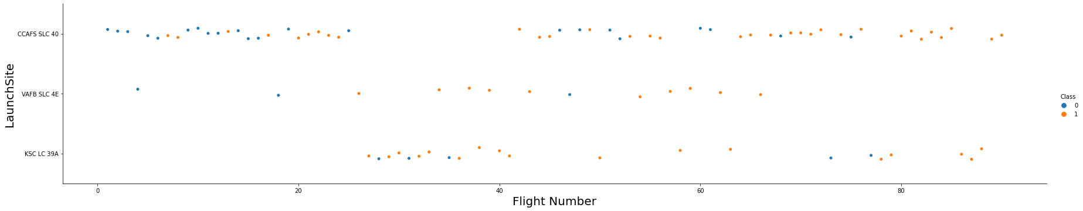
EDA with Data Visualization
To explore data, scatterplots and barplots were used to visualize the relationship between pair of features:
Payload Mass X Flight Number, Launch Site X Flight Number, Launch Site X Payload Mass, Orbit and Flight Number, Payload and Orbit
Source code: https://github.com/tflores/applied-data-science-
capstone/blob/master/EDA%20with%20Data%20Visualization.ipynb
12

Slide 13
EDA with SQL
The following SQL queries were performed:
Names of the unique launch sites in the space mission;
Top 5 launch sites whose name begin with the string 'CCA’;
Total payload mass carried by boosters launched by NASA (CRS);
Average payload mass carried by booster version F9 v1.1;
Date when the first successful landing outcome in ground pad was achieved;
Names of the boosters which have success in drone ship and have payload mass between 4000 and 6000 kg;
Total number of successful and failure mission outcomes;
Names of the booster versions which have carried the maximum payload mass;
Failed landing outcomes in drone ship, their booster versions, and launch site names for in
year 2015; and
Rank of the count of landing outcomes (such as Failure (drone ship) or Success (ground
pad)) between the date 2010-06-04 and 2017-03-20.
13
•
Source code: https://github.com/tflores/applied-data-science-capstone/blob/master/EDA.ipynb

Slide 14
Build an Interactive Map with Folium
Markers, circles, lines and marker clusters were used with Folium Maps
Markers indicate points like launch sites;
Circles indicate highlighted areas around specific coordinates, like NASA Johnson Space
Center;
Marker clusters indicates groups of events in each coordinate, like launches in a launch site;
and
Lines are used to indicate distances between two coordinates.
Source code: https://github.com/tflores/applied-data-science- capstone/blob/d232d76932163635b072952f121a8d70286e0d84/Interactive%20Visual%20Analytics%20with%20Folium%20l ab.ipynb

Slide 15
Build a Dashboard with Plotly Dash
The following graphs and plots were used to visualize data
Percentage of launches by site
Payload range
This combination allowed to quickly analyze the relation between payloads and launch sites, helping to identify where is best place to launch according to payloads.
Source code: https://github.com/tflores/applied-data-science- capstone/blob/d232d76932163635b072952f121a8d70286e0d84/spacex_dash_app.py

Slide 16





Predictive Analysis (Classification)
Four classification models were compared: logistic regression, support vector machine, decision tree and k nearest neighbors.
Test of each model with combinations of hyperparameters
Data preparation and standardization
Comparison of results
Source code: https://github.com/tflores/applied-data-science- capstone/blob/d232d76932163635b072952f121a8d70286e0d84/Machine%20Learning%20Prediction.ipynb

Slide 17
Results
Exploratory data analysis results:
Space X uses 4 different launch sites;
The first launches were done to Space X itself and NASA;
The average payload of F9 v1.1 booster is 2,928 kg;
The first success landing outcome happened in 2015 fiver year after the first launch;
Many Falcon 9 booster versions were successful at landing in drone ships having payload above the average;
Almost 100% of mission outcomes were successful;
Two booster versions failed at landing in drone ships in 2015: F9 v1.1 B1012 and F9 v1.1 B1015;
The number of landing outcomes became as better as years passed.

Slide 18
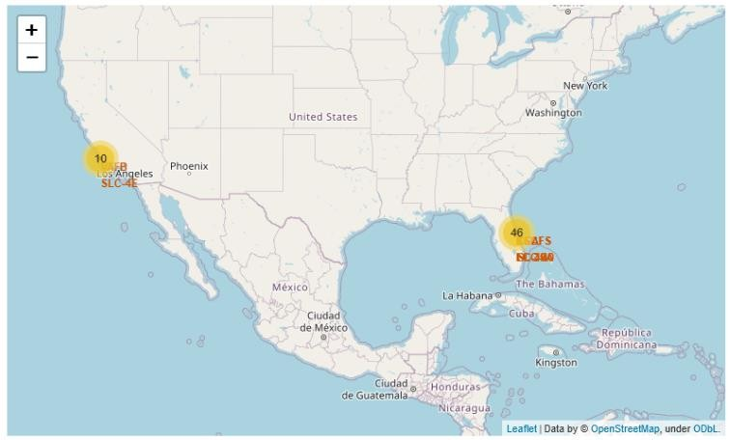
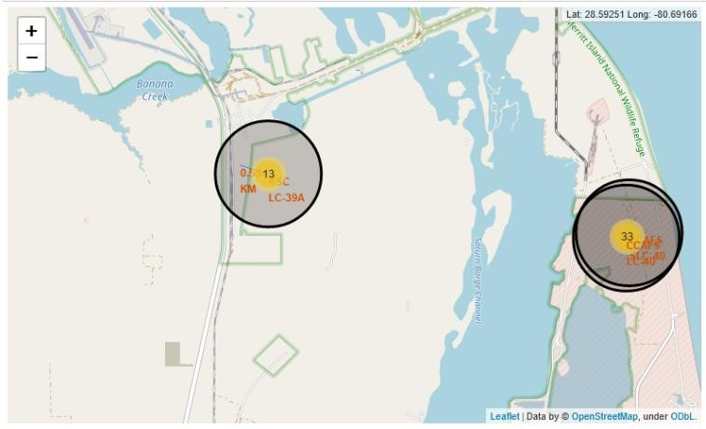
Results
Using interactive analytics was possible to identify that launch sites use to be in
safety places, near sea, for example and have a good logistic infrastructure around.
Most launches happens at east cost launch sites.

Slide 19
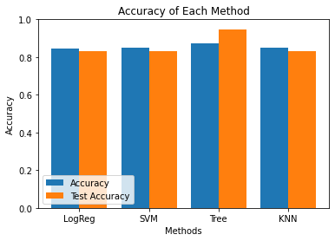
Results
Predictive Analysis showed that Decision Tree Classifier is the best model to predict successful landings, having accuracy over 87% and accuracy for test data over 94%.

Slide 20


Slide 21
Flight Number vs. Launch Site
According to the plot above, it’s possible to verify that the best launch site
nowadays is CCAF5 SLC 40, where most of recent launches were successful;
In second place VAFB SLC 4E and third place KSC LC 39A;
It’s also possible to see that the general success rate improved over time.

Slide 22
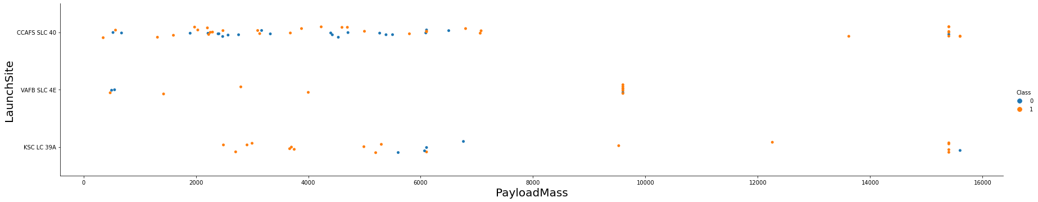
Payload vs. Launch Site
Payloads over 9,000kg (about the weight of a school bus) have excellent success
rate;
Payloads over 12,000kg seems to be possible only on CCAFS SLC 40 and KSC LC
39A launch sites.

Slide 23
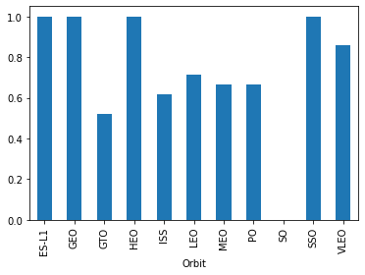
Success Rate vs. Orbit Type
The biggest success rates happens to orbits:
ES-L1;
GEO;
HEO; and
SSO.
Followed by:
VLEO (above 80%); and
LFO (above 70%).

Slide 24
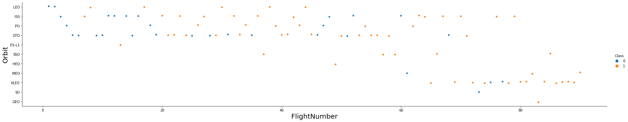
Flight Number vs. Orbit Type
Apparently, success rate improved over time to all orbits;
VLEO orbit seems a new business opportunity, due to recent increase of its
frequency.

Slide 25
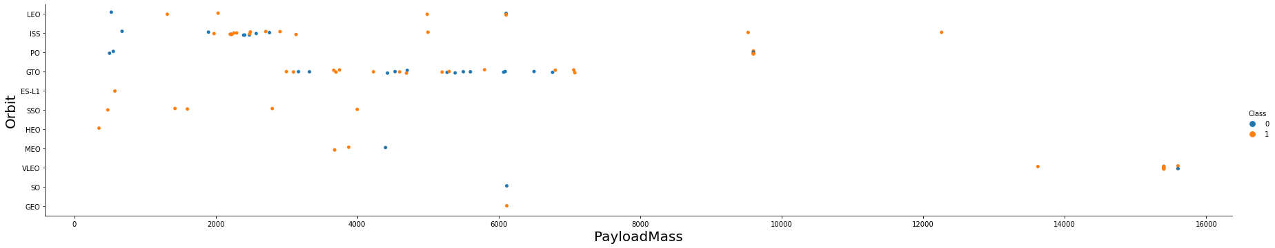
Payload vs. Orbit Type
Apparently, there is no relation between payload and success rate to orbit GTO;
ISS orbit has the widest range of payload and a good rate of success;
There are few launches to the orbits SO and GEO.

Slide 26
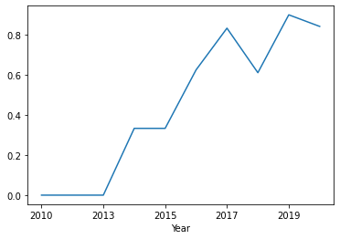
Launch Success Yearly Trend
Success rate started increasing in 2013 and
kept until 2020;
It seems that the first three years were a period of adjusts and improvement of technology.

Slide 27
All Launch Site Names
According to data, there are four launch sites:
Launch Site
CCAFS LC-40
CCAFS SLC-40
KSC LC-39A
VAFB SLC-4E
They are obtained by selecting unique occurrences of “launch_site” values
from the dataset.

Slide 28
Launch Site Names Begin with 'CCA'
5 records where launch sites begin with `CCA`:
Date | Time UTC | Booster Version | Launch Site | Payload | Payload Mass kg | Orbit | Customer | Mission Outcome | Landing Outcome
2010-06-04 | 18:45:00 | F9 v1.0 B0003 | CCAFS LC-40 | Dragon Spacecraft Qualification Unit | 0 | LEO | SpaceX | Success | Failure (parachute)
2010-12-08 | 15:43:00 | F9 v1.0 B0004 | CCAFS LC-40 | Dragon demo flight C1, two CubeSats, barrel of Brouere cheese | 0 | LEO (ISS) | NASA (COTS) NRO | Success | Failure (parachute)
2012-05-22 | 07:44:00 | F9 v1.0 B0005 | CCAFS LC-40 | Dragon demo flight C2 | 525 | LEO (ISS) | NASA (COTS) | Success | No attempt
2012-10-08 | 00:35:00 | F9 v1.0 B0006 | CCAFS LC-40 | SpaceX CRS-1 | 500 | LEO (ISS) | NASA (CRS) | Success | No attempt
2013-03-01 | 15:10:00 | F9 v1.0 B0007 | CCAFS LC-40 | SpaceX CRS-2 | 677 | LEO (ISS) | NASA (CRS) | Success | No attemp
Here we can see five samples of Cape Canaveral launches.

Slide 29
Total Payload Mass
Total payload carried by boosters from NASA:
Total Payload (kg)
111.268
Total payload calculated above, by summing all payloads whose codes
contain ‘CRS’, which corresponds to NASA.

Slide 30
Average Payload Mass by F9 v1.1
Average payload mass carried by booster version F9 v1.1:
Avg Payload (kg)
2.928
Filtering data by the booster version above and calculating the average
payload mass we obtained the value of 2,928 kg.

Slide 31
First Successful Ground Landing Date
First successful landing outcome on ground pad:
Min Date
2015-12-22
By filtering data by successful landing outcome on ground pad and getting the minimum value for date it’s possible to identify the first occurrence, that happened on 12/22/2015.

Slide 32
Successful Drone Ship Landing with Payload between 4000 and 6000
Boosters which have successfully landed on drone ship and had payload mass greater than 4000 but less than 6000
Booster Version
F9 FT B1021.2
F9 FT B1031.2
F9 FT B1022
F9 FT B1026
Selecting distinct booster versions according to the filters above, these 4 are the result.

Slide 33
Total Number of Successful and Failure Mission Outcomes
Number of successful and failure mission outcomes:
Mission Outcome | Occurrences
Success | 99
Success (payload status unclear) | 1
Failure (in flight) | 1
Grouping mission outcomes and counting records for each group led us to the summary above.

Slide 34
Boosters Carried Maximum Payload
Boosters which have carried the maximum payload mass
Booster Version (...)
F9 B5 B1048.4
F9 B5 B1048.5
F9 B5 B1049.4
F9 B5 B1049.5
F9 B5 B1049.7
F9 B5 B1051.3
Booster Version
F9 B5 B1051.4
F9 B5 B1051.6
F9 B5 B1056.4
F9 B5 B1058.3
F9 B5 B1060.2
F9 B5 B1060.3
These are the boosters which have carried the maximum payload mass registered in the dataset.

Slide 35
2015 Launch Records
Failed landing outcomes in drone ship, their booster versions, and launch site names for in year 2015
Booster Version | Launch Site
F9 v1.1 B1012 | CCAFS LC-40
F9 v1.1 B1015 | CCAFS LC-40
The list above has the only two occurrences.

Slide 36
Rank Landing Outcomes Between 2010-06-04 and 2017-03-20
Ranking of all landing outcomes between the date 2010-06-04 and 2017-
03-20:
Landing Outcome | Occurrences
No attempt | 10
Failure (drone ship) | 5
Success (drone ship) | 5
Controlled (ocean) | 3
Success (ground pad) | 3
Failure (parachute) | 2
Uncontrolled (ocean) | 2
Precluded (drone ship) | 1
This view of data alerts us that “No attempt” must be taken in account.

Slide 37


Slide 38
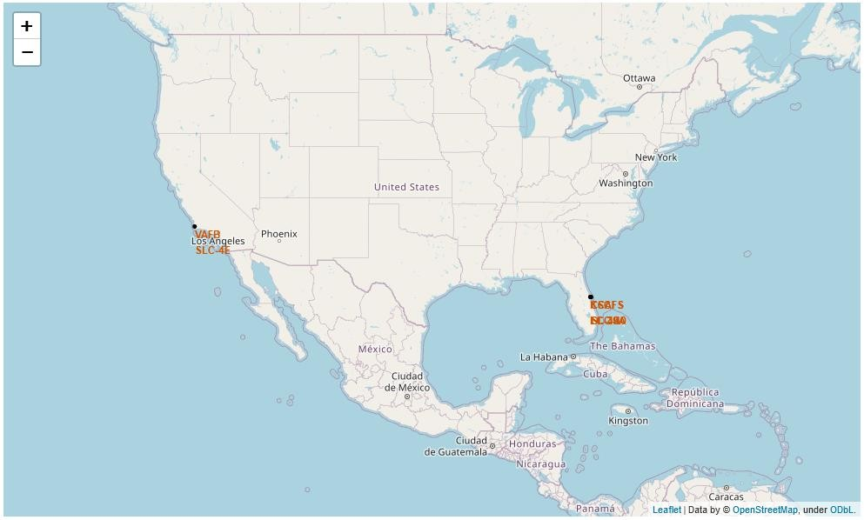
All launch sites
Launch sites are near sea, probably by safety, but not too far from roads and
railroads.
38

Slide 39

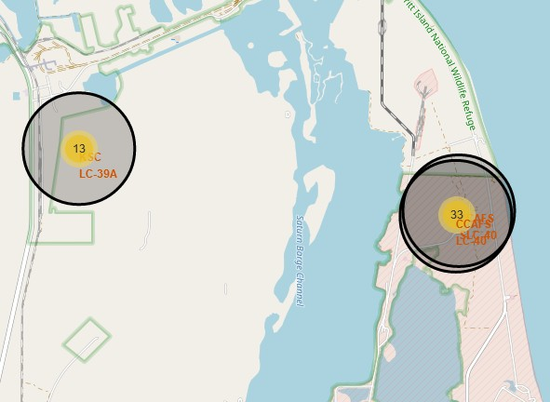
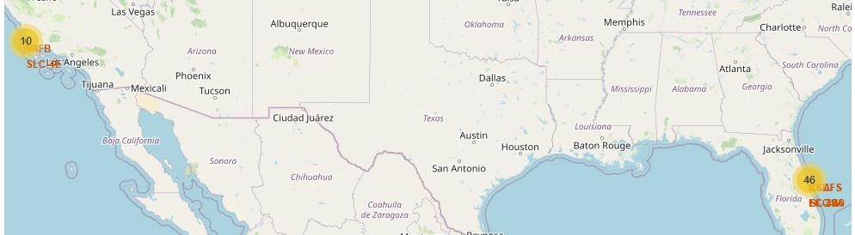

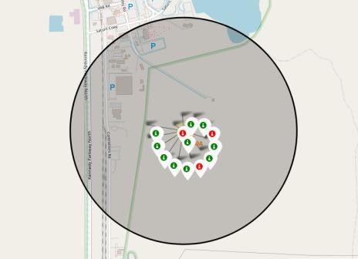
Launch Outcomes by Site
Example of KSC LC-39A launch site launch outcomes
Green markers indicate successful and red ones indicate failure.

Slide 40
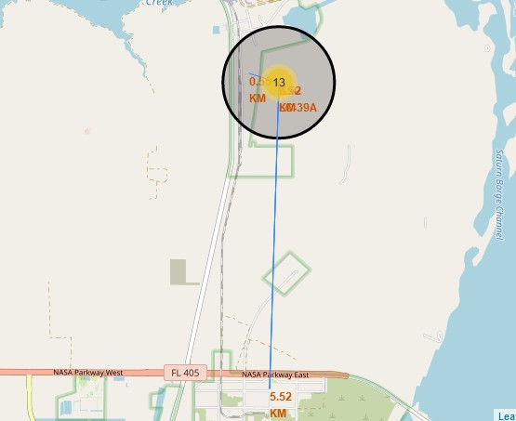
Logistics and Safety
Launch site KSC LC-39A has good logistics aspects, being near railroad and road and relatively far from inhabited areas.

Slide 41


Slide 42
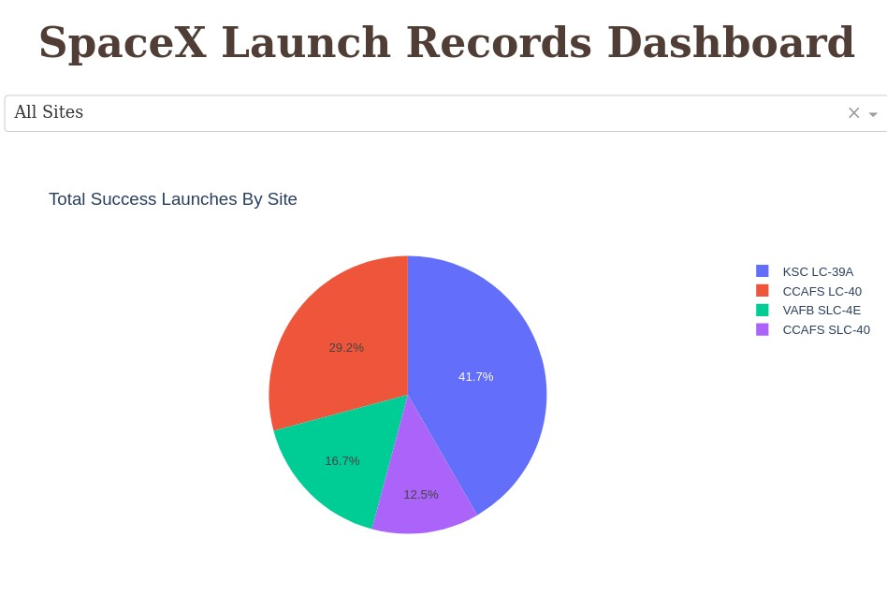
Successful Launches by Site
The place from where launches are done seems to be a very important factor of
success of missions.

Slide 43
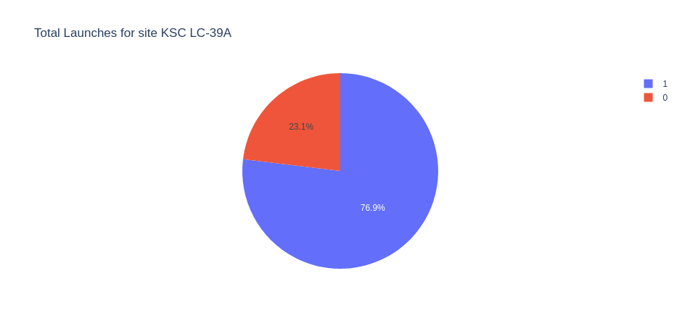
Launch Success Ratio for KSC LC-39A
76.9% of launches are successful in this site.

Slide 44
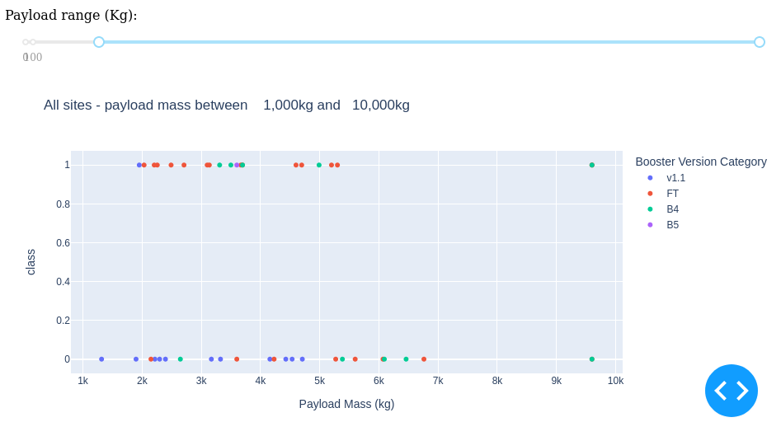
Payload vs. Launch Outcome
Payloads under 6,000kg and FT boosters are the most successful combination.

Slide 45
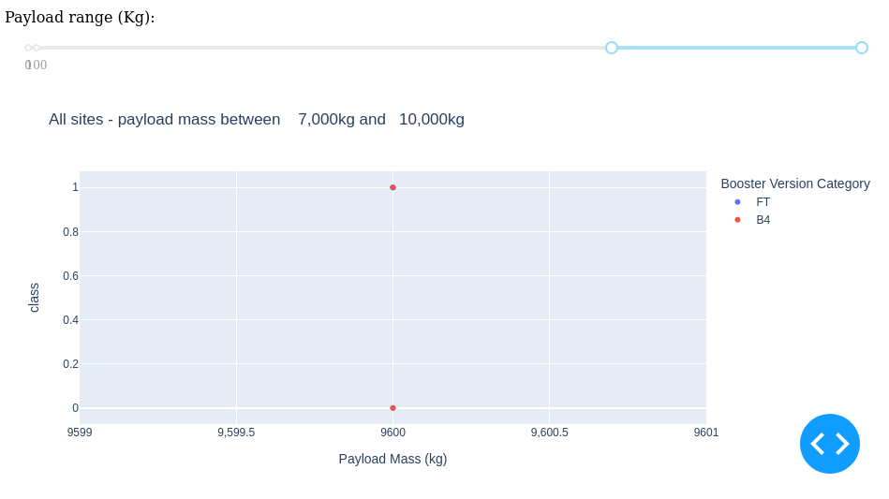
Payload vs. Launch Outcome
There’s not enough data to estimate risk of launches over 7,000kg

Slide 46


Slide 47
Classification Accuracy
Four classification models were tested, and their accuracies are plotted beside;
The model with the highest classification accuracy is Decision Tree Classifier, which has accuracies over than 87%.

Slide 48
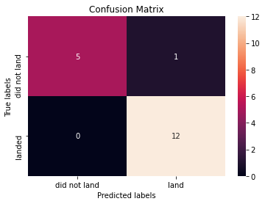
Confusion Matrix of Decision Tree Classifier
Confusion matrix of Decision Tree Classifier proves its accuracy by showing the big
numbers of true positive and true negative compared to the false ones.

Slide 49
Conclusions
Different data sources were analyzed, refining conclusions along the
process;
The best launch site is KSC LC-39A;
Launches above 7,000kg are less risky;
Although most of mission outcomes are successful, successful landing outcomes seem to improve over time, according the evolution of processes and rockets;
Decision Tree Classifier can be used to predict successful landings and
increase profits.

Slide 50
Appendix
As an improvement for model tests, it’s important to set a value to
np.random.seed variable;
Folium didn’t show maps on Github, so I took screenshots.

Slide 51


